Slide 1
Boston Marathon Bombing:
Responding to Crisis
Richard DesLauriers, Former SAC, Boston FBI
Notes:
U.S. Attorney Carmen Ortiz
Former FBI SAC Rick DesLauriers

Slide 2
Agenda
Introduction – District of Massachusetts
Background – Patriots’ Day & Boston Marathon
Timeline – Week of Bombing
Investigation
Related cases: Kadyrbayev, Tazhayakov, Phillipos, Matanov
Trial of Dzhokhar Tsarnaev
Key Lessons
Final Thoughts
Notes:
Overview of the District of Massachusetts
Background of Patriots’ Day and significance of the Boston Marathon
Timeline and perspective during the week of the bombing
Investigation
Related cases involving criminal conduct by the Tsarnaev brothers’ friends
Two-phase trial of Dzhokhar Tsarnaev
Key lessons involving law enforcement protocol, medical response, victim services, etc…
And some final thoughts

Slide 3
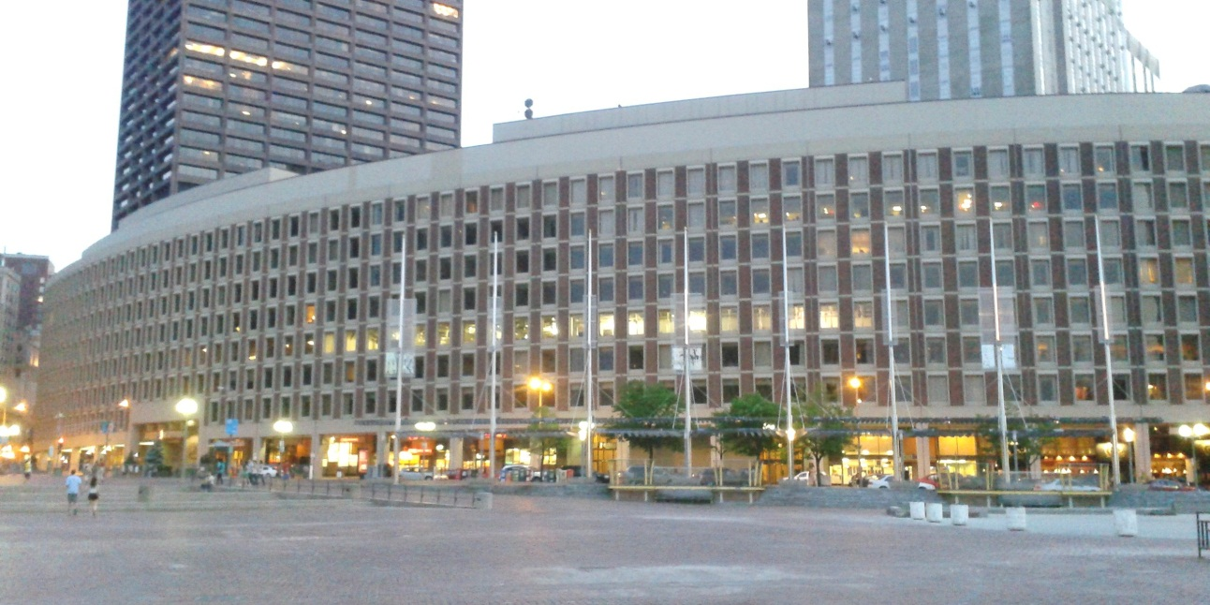
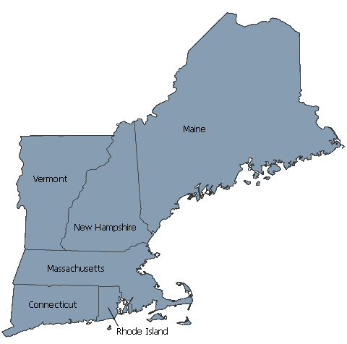
District of Massachusetts
FBI Boston
Moakley Federal Courthouse
Notes:
U.S. Attorney
USA since 2009
USAO is headquartered at Moakley Courthouse in Boston
D-MA is an extra-large district known for its robust prosecution of public corruption cases (State Speaker of the House and several other high-ranking state legislators, Mass Probation Dept.), organized crime (Whitey Bulger), health care fraud (GSK, J&J, NECC), and national security cases (Tarek Mehanna, Richard Reid, Boston Marathon)
FBI
SAC from July 2010 – July 2013
Field office covers all six New England states

Slide 4
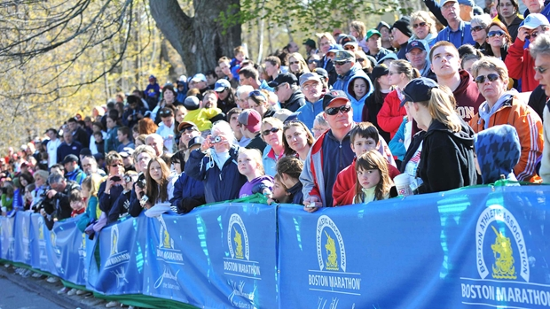
Background
Patriots’ Day
Boston Marathon
Notes:
Massachusetts Holiday – engrained in culture
One of the most prestigious marathons – draws runners, spectators and media from all over the world
~Half a million spectators along the 26.2 mile route and 100 credentialed media outlets
Simultaneous Red Sox game at Fenway Park

Slide 5
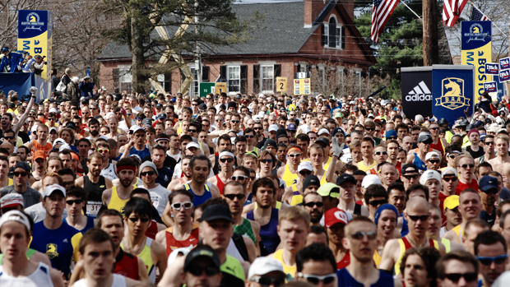
Monday – Patriots’ Day Apri1 15, 2013
Beginning of Marathon course
Hopkinton, 10:00 a.m.
Finish line near Copley Square
Boston, 2:49 p.m.
Notes:
Two bombs explode near the finish line of the Marathon on Beacon Street at 2:49 pm
News of bombings was nearly instantaneous due to presence of media
Emergency response
Injured transferred to hospitals around Boston
Law enforcement meets at Westin Hotel in Copley Square
Securing the city
Reports of pipe bombs/explosions at other locations contributed to uncertainty
Electrical fire at JFK Library
So many unknowns – were there more bombs in the city? In other cities?
Launch of investigation by law enforcement – all hands on deck
In office (staffing meeting), then headed to command post
Rick immediately responded to scene. Call from Commissioner Davis (BPD)
Press conference at 4:50 pm
Up until that point, Boston Police were the lead agency. Prior to the press conference, the FBI/USAO asserted federal authority

Slide 6
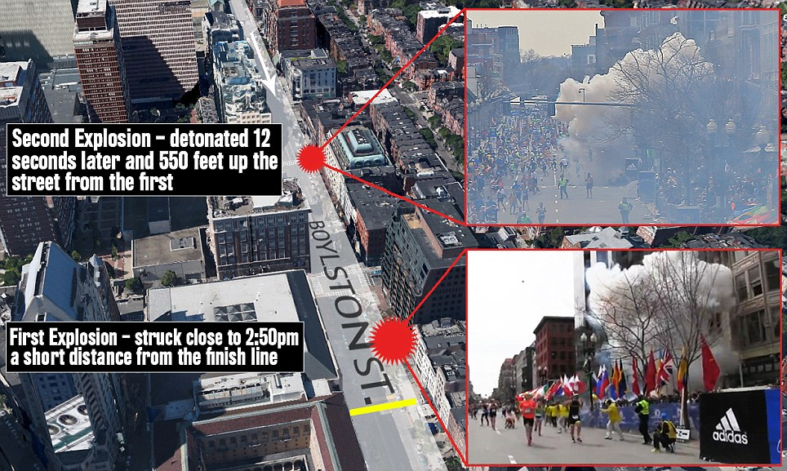
Explosion Timeline
Notes:
Fist bomb explodes a short distance from the finish line
12 seconds later, a second bomb explodes in front of the Forum restaurant

Slide 7
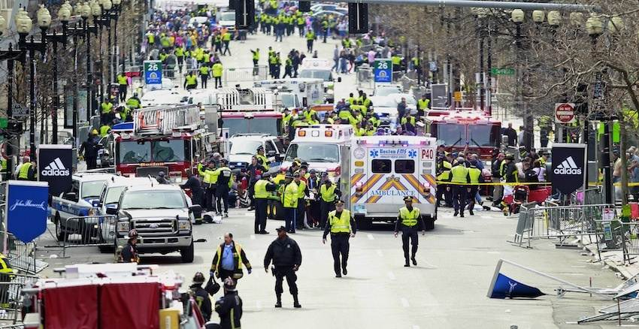
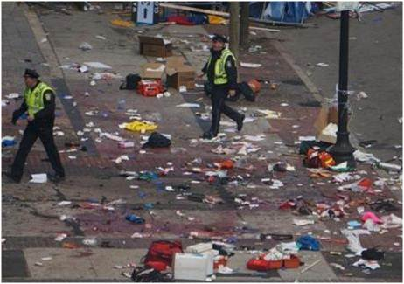
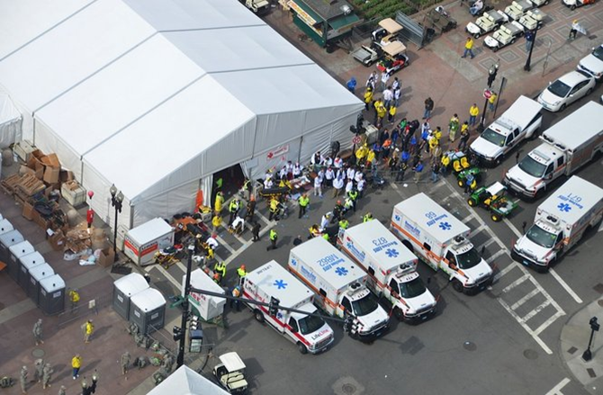
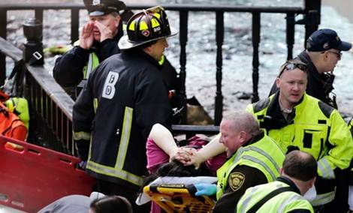
Scene Response
Notes:
Law enforcement and medical personnel already on the scene and on stand-by for the Marathon
All 264 injured were evacuated and transported to hospitals within 22 minutes.

Slide 8
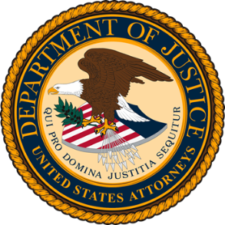
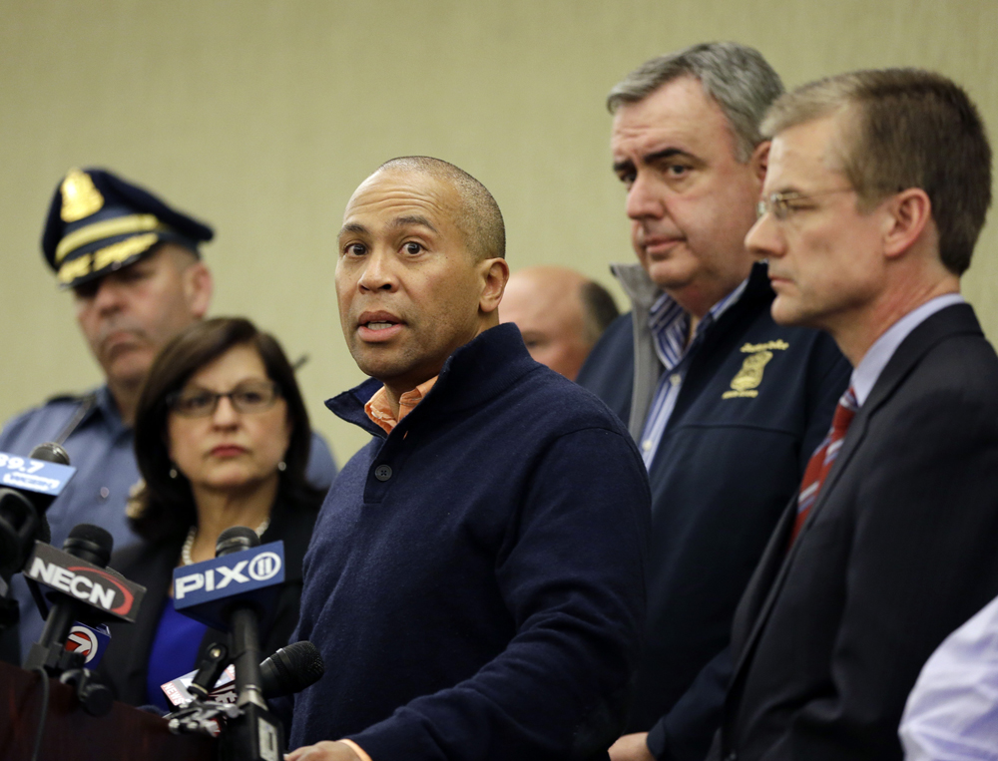
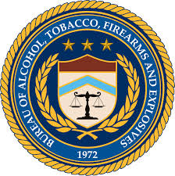
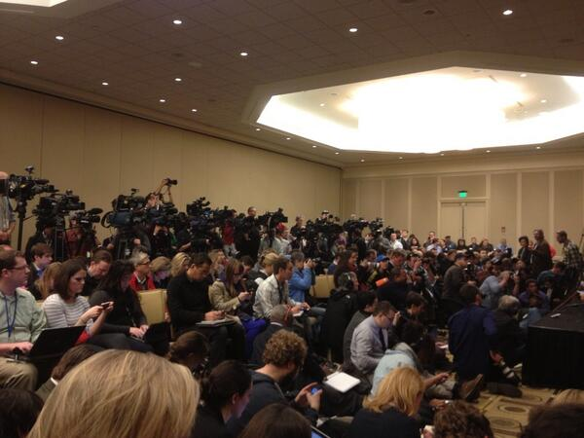
United Front
Notes:
Governor took initial lead - reassure residents
Local, state, federal law enforcement participated
Politicians – challenge of keeping informed
Constant communication and decision making between agency leaders

Slide 9
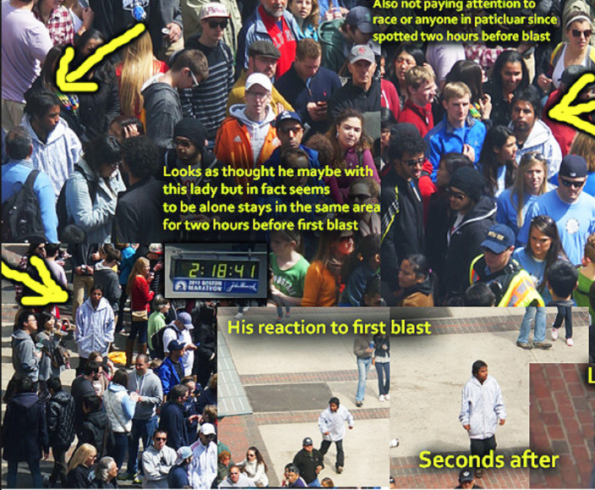
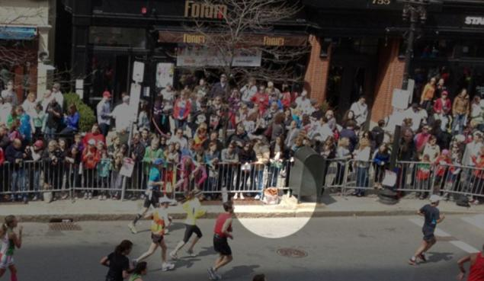
Tuesday
President Obama declares bombing “an act of terror”
Inaccurate reports run rampant
Photo-shopped image
Notes:
President Obama announces that FBI is investigating “an act of terrorism”
Inaccurate reports run rampant

Slide 10
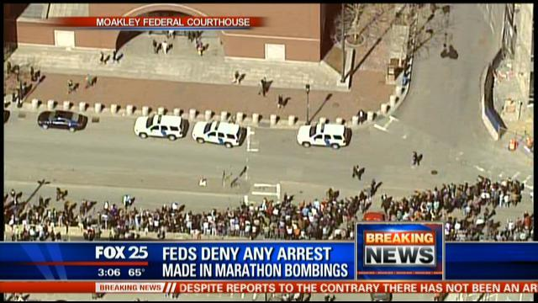
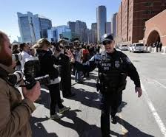
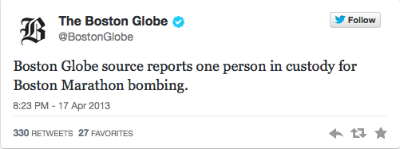
Wednesday
Notes:
False reports of arrested suspect(s) leads to bomb threat and evacuation of federal courthouse

Slide 11
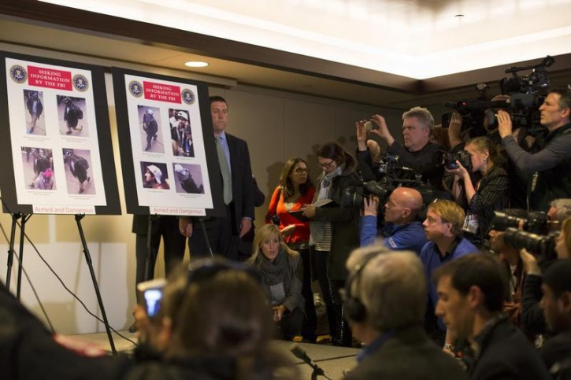
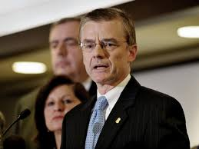
Thursday Release of Suspect Photos
Notes:
Photos of suspects released at press conference
Significant discussion among USA, FBI SAC, MSP Colonel, BPD Commissioner
Potential payoff: quick ID of suspects from tipster
Potential consequence: suspects flee if they hadn’t already and/or cause more violence

Slide 12
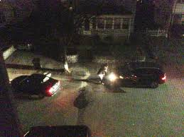
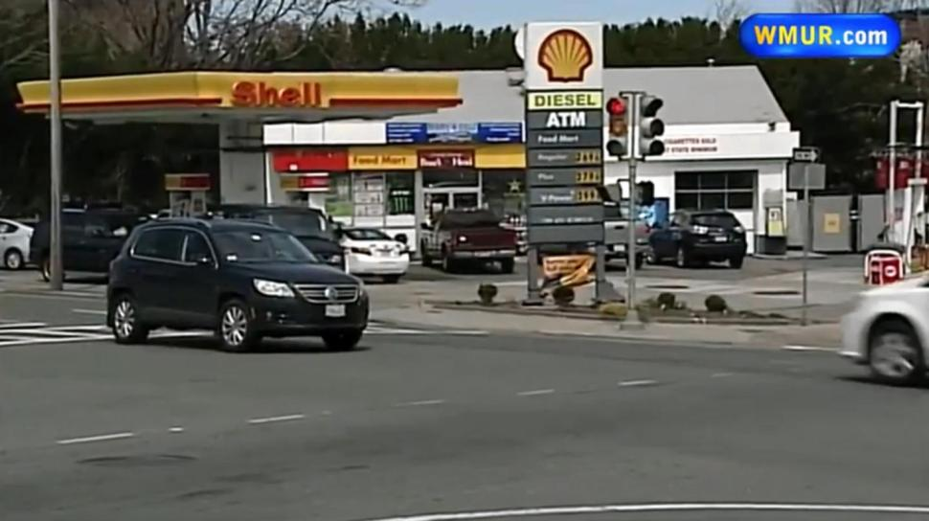
Thursday Night
1. Shooting of MIT Police Officer
3. Watertown - first shootout
2. Carjacking victim escapes
Notes:
Suspects shot and kill MIT Police Officer who is on patrol
Tamerlan carjacks a man pulled over on the side of the road in Brighton
Instructs man to drive and tells him he is the bomber
Pick up Dzhokhar and transfer weapons into vehicle
Stop at gas station where kidnapee escapes
Engage in shootout with police in Watertown
Detonate another pressure cooker bomb
Tamerlan is killed when run over by Dzhokhar, who escapes

Slide 13
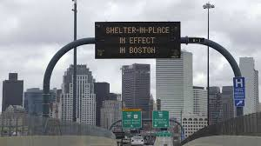
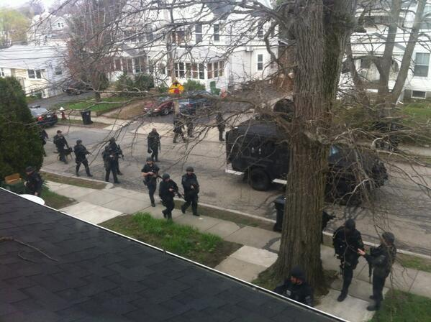
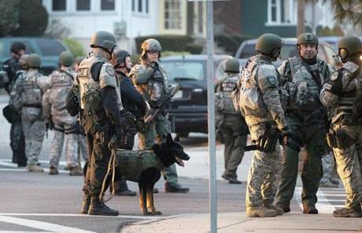
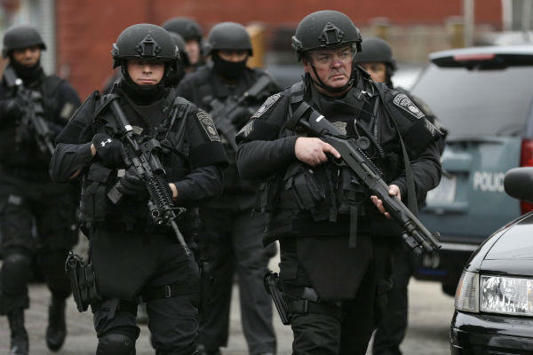
Friday Manhunt Spans Greater Boston
Notes:
Governor initiates shelter-in-place order and manhunt is launched to find remaining suspect-at-large
Unsuccessful block-by-block search
Shelter-in-place order lifted at 6pm

Slide 14
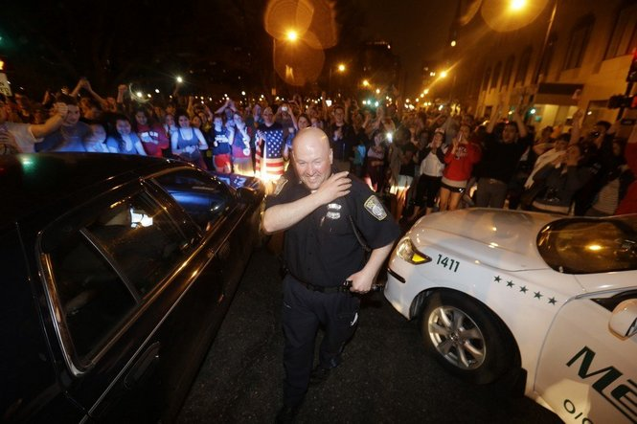
Watertown Shootout & Capture
Notes:
Dzhokhar found hiding in boat in Watertown resident’s yard and taken alive by law enforcement and immediately transported to hospital for medical attention

Slide 15
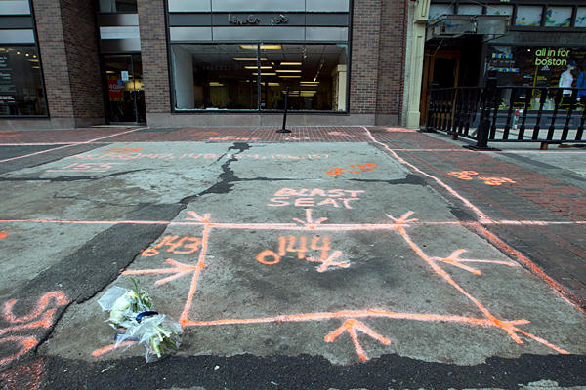
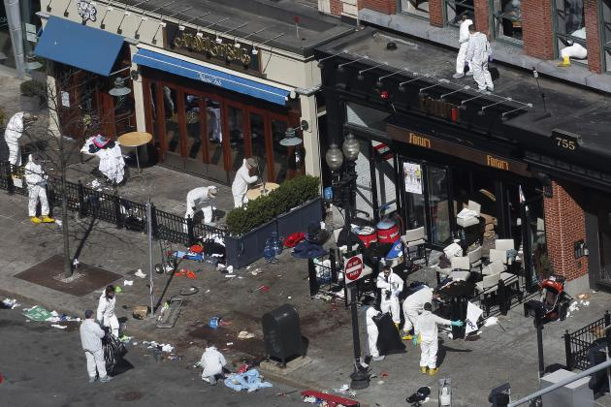
Investigation
Evidence collection
Seat of blast
Notes:
Many questions: How were the devices detonated? What motivated the suspects? Were others aware of plans for the attack? Did the suspects act alone or on behalf of a foreign regime/criminal organization?

Slide 16
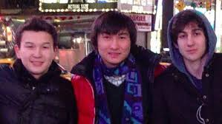
Related Cases
Kadyrbayev
Pled guilty and sentenced to six years in prison for retrieving and later disposing of evidence (Tsarnaev’s backpack containing opened fireworks) connected to the investigation
Tazhayakov
Convicted and sentenced to 3.5 years in prison for helping Kadyrbayev to remove and dispose of evidence from Tsarnaev’s dorm room.
Notes:
During the investigation, it was discovered that Dzhokhar’s friends were responsible for attempting to impede the investigation by removing crucial evidence from his dorm room
Kadyrbayev and Tazayakov went into Dzhokhar’s dorm room and found items that linked him to the bombing, including fireworks, a jar of Vaseline, a laptop, thumb drive, and backpack. They removed and disposed of the items in a dumpster
Kadyrbayev pleaded guilty and was sentenced to six years in prison
Tazhayakov was convicted and sentenced to 3.5 years in prison

Slide 17
Related Cases
Phillipos
Convicted and sentenced to three years in prison for lying to federal agents about being with Tazhayakov and Kadyrbayev when they removed Tsarnaev’s backpack from his dorm room
Matanov
Pled guilty and sentenced to 2.5 years in prison for misleading agents about his relationship with the Tsarnaev brothers.
Notes:
Robel Phillipos, another of Dzhokhar’s college friends, was convicted of making false statements to investigators
He was interviewed five times by law enforcement, and not until the end of the fifth interview did Phillips admit that he, Kadyrbayev, and Tazayakov went into Dzhokhar’s room, removed, and disposed of critical evidence
Khairullozhon Matanov, a friend of the Tsarnaevs, pleaded guilty to concealing a material fact in a federal investigation and making false statements to federal investigators
Matanov took steps to cover his relationship and contact with the Tsarnaevs and his own views of terrorism by deleting information from his computer, which contained violent content and calls to violence
Matanov pleaded guilty and was sentenced to 30 months in prison.

Slide 18
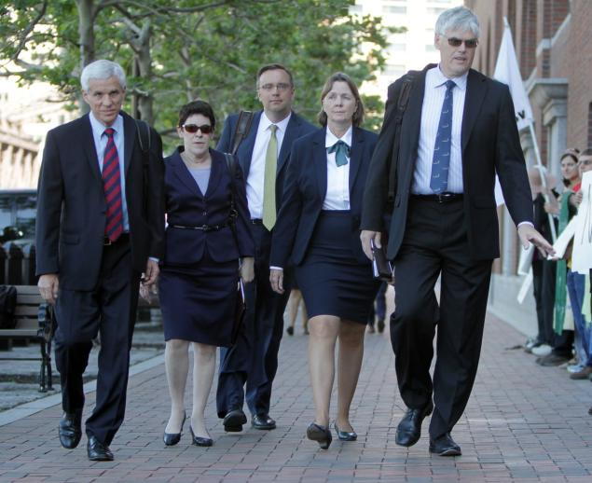
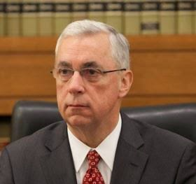
Trial of Dzhokhar Tsarnaev
↑ Prosecution Team: William Weinreb, Al Chakravarty, Nadine Pellegrini, Steve Mellin
↑ Defense Team: David Bruck, Miriam Conrad, William Fick, Judy Clark, Timothy Watkins
Judge George A. O’Toole, Jr.
Notes:
Jury selection began in January and proceeded slowly as Judge was determined that a fair and impartial jury could be selected in Boston
In February, phase one of trial to determine Tsarnaev’s guilt or innocence began
On April 18th, the jury convicted Tsarnaev on all 30 counts. The trial featured graphic testimony from survivors, victims, and witnesses, physical and electronic evidence, and expert testimony
The same jury then heard arguments in the second phase of the trail to determine Tsarnaev’s sentence
In May 2015, the jury recommended that Tsarnaev be sentenced to death
Coordination of the trial involved the numerous law enforcement entities – court, USAO, public defenders, USMS, court security officers, FBI, BPD, Mass State Police, Coast Guard, victim service providers, public information officers, etc…

Slide 19
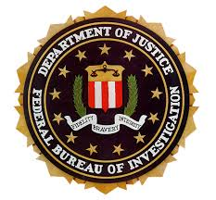
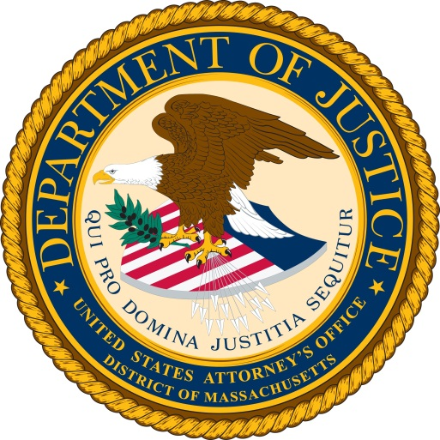
Victim Impact & Response
Many organizations provide victim services
FBI, USAO, state & city agencies, non-profits
“One Fund” created to help the injured - $61M distributed thus far
Notes:
Unprecedented number of victims and witnesses
As a result, many victim advocacy organizations and service providers came together to provide assistance and support
Incorporating and respecting the needs of the survivors and their families during the trial was challenging

Slide 20
Key Lessons
Collaborative relationships between law enforcement partners are critical
Assembling strong teams is essential
Need to prioritize media relations
Provide immediate and long-term victim assistance
Be prepared to face unexpected challenges that will inevitably arise
Remember that the crisis does not end when the suspect(s) is captured
Notes:
Collaborative relationships between law enforcement partners are critical
Long-standing relationships built on mutual trust and respect among law enforcement leaders contributed to join decision-making throughout the week
The first time you talk with your colleagues should not be during a crisis
Make a point to meet and work with law enforcement leaders as well as the governor, DAs, and senators.
Develop professional and personal relationships based on trust and respect for each other’s experience and priorities.
Assembling strong teams is essential
It is important for leaders to be present – go to the scene and/or command post
We spent nearly the entire week at the command post (Westin Hotel, FBI Headquarters, Watertown)
Consistent presence and leadership ensures smooth communication among parties and joint decision-making
An experienced and full-time PIO is essential
During a crisis situation, you rely on a PIO’s ability to control the flow of information; to disseminate a coordinated and consistent message; to keep all parties informed (i.e. DOJ, Washington); and to harness/handle the media
Build a team of the most experienced, practiced staff.
USA pulled AUSAs from my ATU of course, but also CCU and MCU.
Be prepared for that team to be equipped with portable equipment and backup.
Laptops, chargers, Blackberries with extra batteries
When phone lines are jammed during emergencies, law enforcement can dial *272 to move to the top of the queue.
Handling the media onslaught is challenging
The 24/7 media circuit demands information instantaneously and consistently, especially as a crisis is unfolding.
The Joint Information Center (JIC) was established and staffed by the USAO and FBI.
Vetted all media inquiries and ensured a consistent, unified message.
Consider logistics of assembling a JIC: location, resources, personnel staffing, management, etc…
Balancing the integrity of the investigation with the public’s right to be informed is a constant ebb and flow.
Leaders must be able to make decisions – and stand by them – as to what information is released and when.
Do not assume that the media will not get a hold of sensitive information.
Inaccurate information and leaks can have serious consequences.
Supposed “suspects” and leads flooded the web in the wake of the bombing.
PIOs only corrected misinformation when it affected public safety or individuals’ reputation. PIOs did not get trapped in “you’re right”, “you’re wrong” with reporters.
Leaked information was very disheartening
Do not underestimate the power of social media
Without a doubt, social media has changed the game and we have to learn to embrace it rather than avoid it.
We used Twitter to disseminate information quickly.
In addition to monitoring news stations, we also closely monitored Twitter.
Provide immediate and long-term victim assistance
Immediately mobilize victim-witness staff from all federal law enforcement agencies and reach out to secure regional and national resources.
In such a large-scale incident, identifying victims and reuniting them with family as soon as possible is critical.
Victims were transported to hospitals all over the city.
Once victims were identified, providing information and assistance to victims and families was a priority.
The Family Assistance Center (FAC) was established. It was one-stop-shopping staffed with representatives from state victim service organizations, non-profits, the FBI and USAO. Victims were able to get help and information.
Unexpected challenges will inevitably arise
Example: One local law enforcement agency tweeted that someone related to the case, Robel Phillipos, was in custody while agents were literally approaching his door. That presented an immediate safety issue for those agents.
Example: The families were upset that the alleged suspect was being treated in the same hospital where victims were also staying.
The crisis does not end when the suspect is captured
In the immediate aftermath of a crisis, there is still significant work: continued investigation and analysis, tangential investigations, scene clean-up and re-opening, return of personal affects, enhanced security presence, etc…
Over time these dwindle and are replaced by longer-term objectives: development of criminal case, ongoing victim-care, Congressional inquiries, rebuilding and reclaiming of city, etc…

Slide 21
Final Thoughts
Leaders need to be present
Law enforcement collaboration is crucial
Have a plan in place now
Understand that you can’t control everything
Take care of your people
Notes:
Leaders need to be present
Law enforcement collaboration is crucial
Have a plan in place now
Understand you can’t control everything
Take care of your people

